Slide 1
IMPACT OF TECHNOLOGY IN POLITICS AND GOVERNANCE
Aditya Kushwaha Hrithik Verma
Satyam Sinha
Saumya Kumari

Slide 2
Indian Politics with intersecting technology:
To provide an in depth overview of how the political culture evolved in India in regard to new technologies.
To describe how technologies are inter-related and inter-mingled for all political environments.
To cite examples where people accepted and rejected some technologies throughout the political course of time.
To understand our dependence on technology and explore its invasive nature in sustaining or deteriorating political development.
To seek and understand the use of technology in politics from western developed nations and how India could benefit from them.

Slide 3
Our Objectives
To touch the pre-internet and post internet era in various political activities, governance, and elections and demonstrate how the television, internet, social media and digital society affected the political backbone and its positive and negative consequences.
To recognize occurrences of “technological determinism” and “social constructivism.”
To deepen our knowledge of how technology and humanities in the political sphere in India are amalgamated.

Slide 4
Pre-internet and post internet era
The three politically revolutionary periods:
The aftermath of the First Industrial Revolution the end of the Second Industrial Revolution, and the Information and Telecommunications Era. In the first of these times, the two most important technological advances.
Developments, from a political point of view, were the railroad, which enabled estate agents to move from the metropolitan centre to the furthest reaches of state territory.
In the second era, that is, in the first decades of the twentieth century hundreds of these advances accelerated.
In the third period, the invention of a modern computer was the key event of interest.

Slide 5
Future of technology in governance:
It is a journey that crosses numerous budget cycles and political administrations to adopt a digital government strategy.
Adaptive security
Citizen digital identity
Multichannel citizen engagement
Agile by design
Digital product management
Digitally empowered workforce
Analytics everywhere
Augmented intelligence

Slide 6
Positive aspects of ICT:
How the Digital India Campaign, 2015 of the Modi Government impacted government functioning for the better.
How fast the crucial information and safety practices about the ongoing COVID-19 was delivered through coherent media channels and social media.
Negative aspects of ICT:
The Trolling Army of ruling Political parties and Social Media Influence can heavily favour the Right Wing and alienate the Leftists.
The huge impact of social media and sidelined journalism in delivering truth to the common people has been largely manipulated and used by political parties to feather their own nest.

Slide 7
Technological Determinism & Social Constructivism:
Technological Determinism:
The term is accepted to have been authored by Thorstein Veblen (1857–1929), an American social researcher.
In the absence of precise and explicitly articulated theories, so called folk theories, or cultural mythologies or myths, will come to dominate our thought; these are widely shared, implicit, unarticulated, and superficially plausible beliefs, which generally fall under the rubric of "common sense.
Technological determinism is the theory that technology is an autonomous force that changes society.
Hard determinism can be contrasted out from soft determinism. It would view technology as developing independent from social concerns.
Soft determinism is a more passive view of the way technology interacts with socio-political situations.

Slide 8
Occurrences of Technological Determinism in Indian Politics:
The Rise of ICT and Digital Media:
In 2014, the Lok Sabha elections were the first social media election for 1.2 billion strong India.
The following year, India emerged as a leader in marketing and PR communications, especially in the political arena, a field historically mainly dependent on forms of promotion such as television, print, radio, rallies, etc.
Tech acceptance & rejection as a strong political instance:
It is a basic premise of most futurology that tomorrow will be profoundly shaped by technological change.
In 2019 there was a widespread pushback against technological determinism.

Slide 9
Social Constructivism
Social constructivism claims, like social constructionism, that individuals work together to construct objects.
Social constructivism focuses on the learning of a person that takes place in a group due to his or her interactions.
Strong social constructivism appears to imply that the natural world has a small or non-existent role in the construction of scientific knowledge" According to Maarten Boudry and Filip Buekens, a clear example of this technique in motion is Freudian psychoanalysis.

Slide 10
Strength and Weaknesses:
It is generally accepted at the general level that constructivism is solid, precisely where other methods are typically weak, and vice versa.
Hopf points out that constructivism does not specify the existence of its main causal/constitutive elements: identities, norms, values and social structure, let alone the precise nature of them.
Occurrences of Social Constructivism in Indian Politics:
Agricultural Development leading to strong hold on government by parties.
Weapons Development leading to Political escalation of India.

Slide 11
Technology as a Double-Edged Sword
Advancements in technology that allow us to work and play in ways like never before also allow nefarious elements to cause disruption or harm like never before.
The hacktivist anonymous organization is dedicated to exposing sensitive political and governmental information to the benefit of the public.
Fake news is media written and published usually with the intent to mislead, in order to damage an entity or person, or to gain financially or politically.
Fake news often utilizes sensationalist, dishonest or outright fabricated headlines to increase readership.

Slide 12
Technology used in Elections
Driven by Obama's successful election Big Data campaigns, even the UK's political parties have steadily shifted away from conventional models in recent years.
Modi belongs to the BJP party that won the 2014 Indian elections with the aid of digital open-source resources that put them in direct contact with their voters.
BJP has made smart steps to get in contact with potential voters, using a mix of digital and conventional platforms to hire volunteers, both online and offline.
The 2014 elections heralded the use of data mining in India. For example, on the basis of the user's contact with online posts, browsing history, etc., you can get a sense of the preference of the elector.

Slide 13
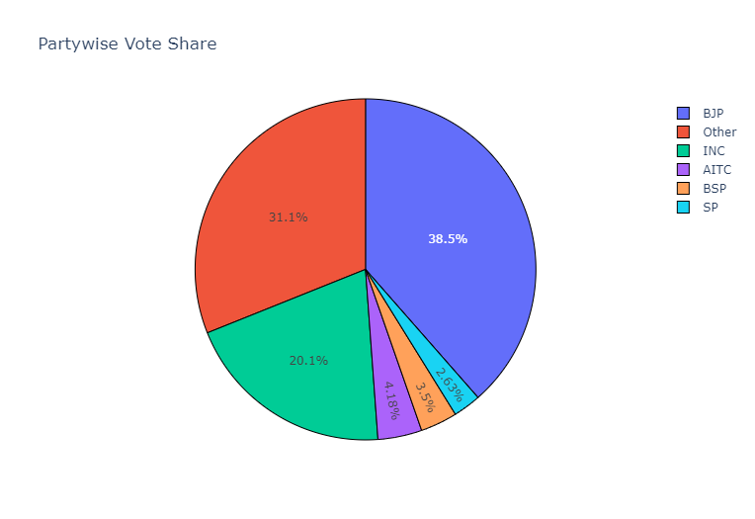
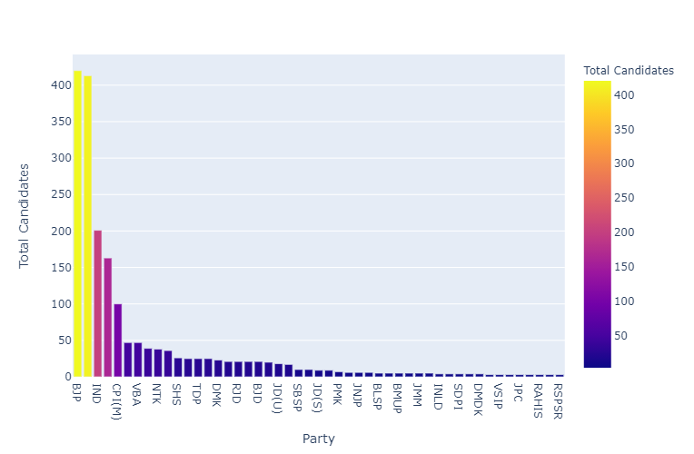
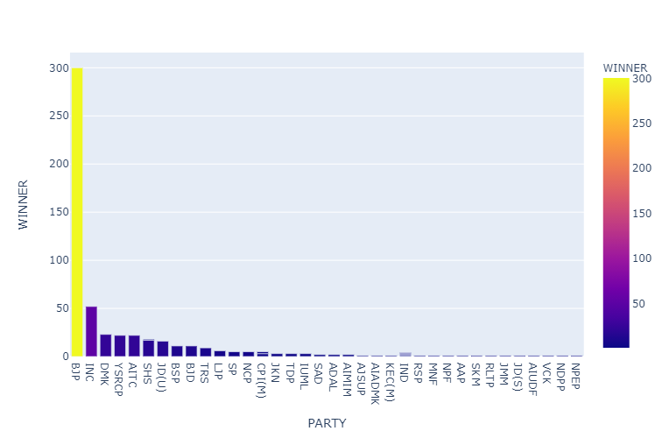
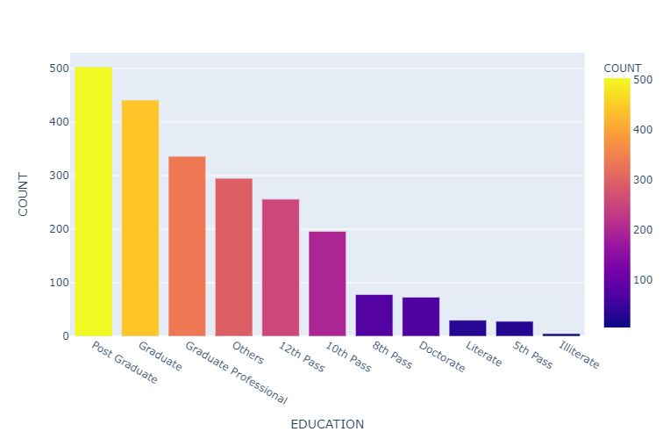
Graphs

Slide 14
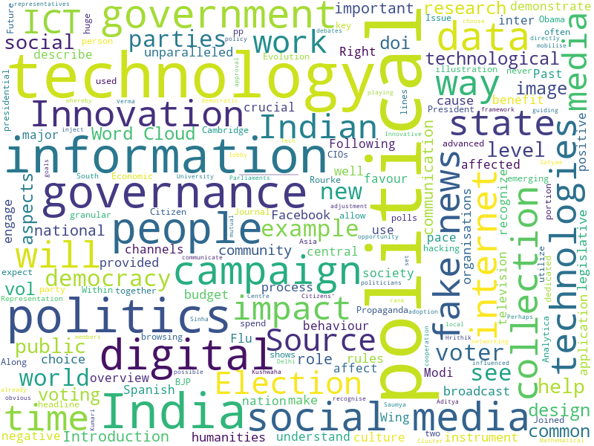
Word Cloud

Slide 15
Thank-You

